Slide 1
CEF 440: INTERNET AND MOBILE PROGRAMMING

Slide 2
Group5
NAMES | MATRICULES
KENNE DATEWO SUZY MAIVA | FE21A214
SIAHA TOUKO AUBIN | FE21A304
DJEUNOU DJEUNOU MARIEKE JETTIE | FE21A168
TSAPZE ZAMBOU ROSELINE CYNTHIA | FE21A328
MATHO SONKWA HESTIE MAYELLE | FE21A438

Slide 3



Mobile App development process
WWW.WEBSITE.COM
WWW.WEBSITE.COM
Planets
Although behind red, Mars is actually a very cold place.
Mercury is the second planet from the Sun
Design and Implementation
SWIPE UP!

Slide 4
Outline
1
Introduction
Major types of mobile apps and comparison
Conclusion
2
3
Programming languages and dev frameworks
4
Architectures and design patterns
5
Collect and analyze user requirements
6
Cost estimation
7
Key steps for development process
8

Slide 5

01
INTRODUCTION

Slide 6
What is a mobile application ?
A mobile application or mobile app is a computer program or software application designed to run on a mobile device such as a phone, tablet, or watch. It is a software that lets you exchange information with customers and help them complete specific tasks

Slide 7
02
Major types of mobile apps and comparison
Native apps
Web apps
Hybrid apps

Slide 8
Major types of mobile apps
Types of apps
Programming languages & frameworks
Architectures
User requirements
Cost estimation
Key steps
Mobile apps can be classified into 3 categories:
1)Native applications
2)Web applications
3)Hybrid applications

Slide 9
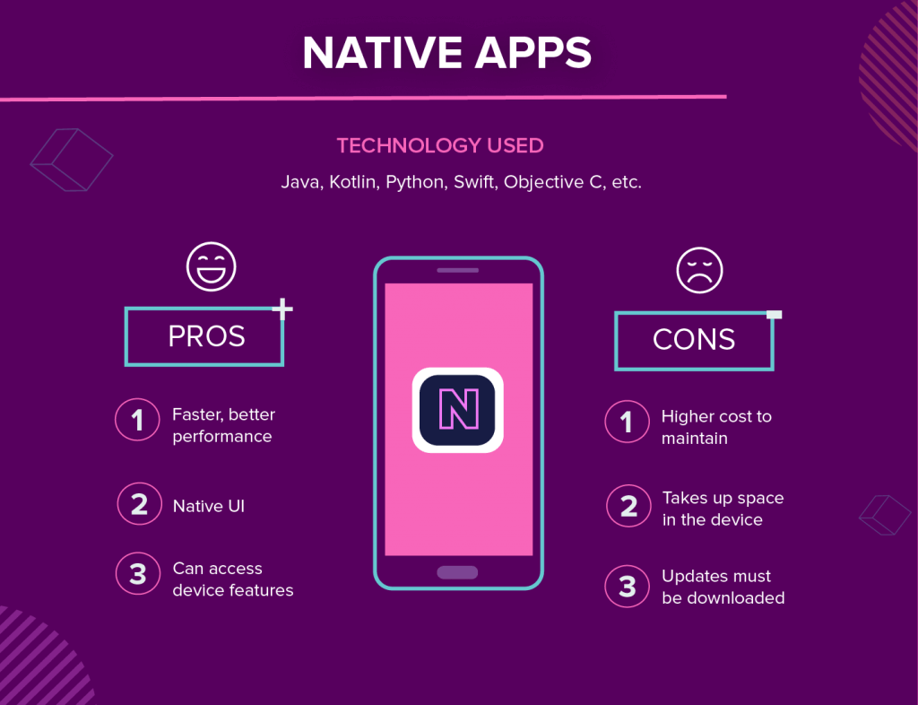
1/3
Native apps
Types of apps
Programming languages & frameworks
Architectures
User requirements
Cost estimation
Key steps
They are built for a specific platform or device type or operating systems.
User must install the appropriate software version on their device of choice from an app store or a marketplace

Slide 10
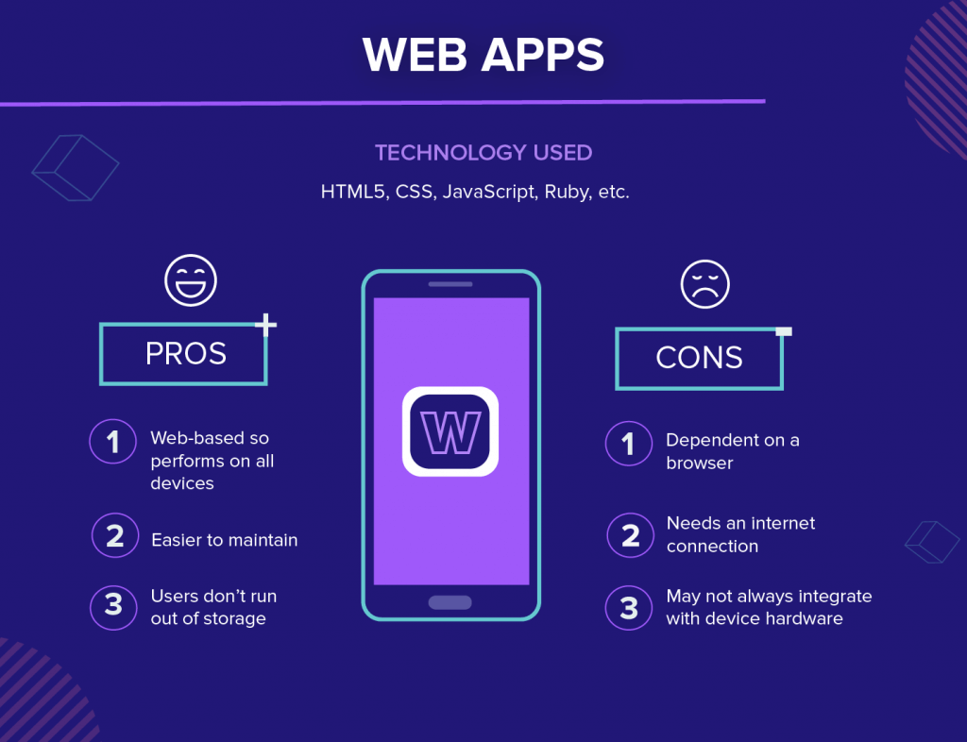
2/3
Web apps
Types of apps
Programming languages & frameworks
Architectures
User requirements
Cost estimation
Key steps
There are accessed through a web browser. Web applications are delivered on the World Wide Web to users with an active network connection.
User don’t need to install them to their devices

Slide 11
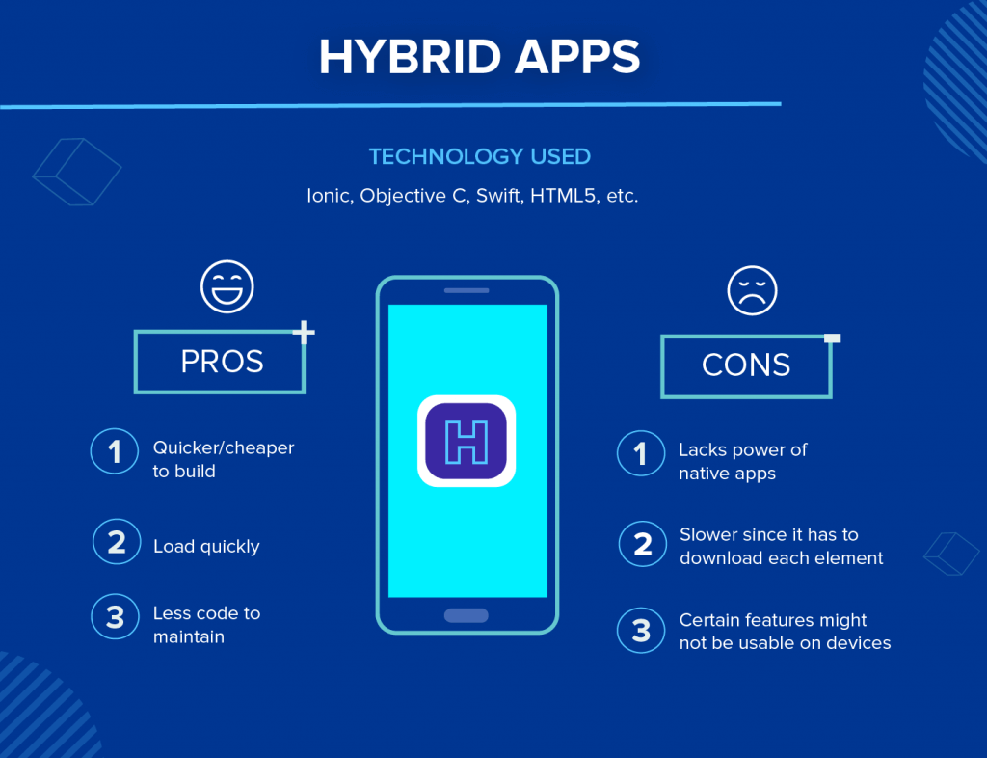
3/3
Hybrid apps
Types of apps
Programming languages & frameworks
Architectures
User requirements
Cost estimation
Key steps
They are native applications with a web browser embedded inside them (e.g.: Facebook,
Instagram, Gmail, Discord)
User can choose to either install them or not to their devices

Slide 12
Native vs web vs hybrid apps
Types of apps
Programming languages & frameworks
Architectures
User requirements
Cost estimation
Key steps
Characteristics | Web app | Hybrid app | Native app
Usage | Users can access directly from a browser | User have to install the app on their device | Users have to install the app on their device
Internal working | Client code in the browser communicates with remote server-side code and DB | Client code and browser code wrapped in natives shell or container | Client code writing in technology and language specific to the device or platform will be installed on
Native device feature | Not accessible | Accessible | Accessible
User experience | Inconsistent and dependent on the browser being used | Consistent and engaging | Consistent and engaging
Access | Limited by browsers and network connectivity | One – step access with offline features | One – step access with offline features
Performance | Slower and less responsive | Faster, but may consume more battery power | Performance can be optimized to device
Development | Cost-efficient, faster time to market | Cost-efficient, faster time to market | Expensive, slower time to market
Src: Amazon

Slide 13
03
Programming languages and dev frameworks

Slide 14
Mobile Programming languages
Types of apps
Programming languages & frameworks
Architectures
User requirements
Cost estimation
Key steps
Programming language | platform | Operating system | Level of difficulty | Framework | Programmer experience
javascript | Hybrid app Web apps | Android and IOS | Easy to learn | React native | beginner
kotlin | Native app | Android | Easy to learn | Native android SDK | beginner
Java | Native app | Android | Easy to learn | - | intermediate
Swift | Native app | IOS | Easy to learn | Native IOs | beginner
Objective-C | Native app | IOS | Easy to learn | - | beginner
C# | Hybrid apps | Android and IOS | intermediate | Xamarin | intermediate
Dart | Hybrid apps | Android and IOS | Easy to learn | Flutter | beginner
Python | Hybrid apps | Android & ios | One of the easiest PL | kivy | beginner
C++ | Hybrid apps | Android & IOS | Hard to learn | Microsoft tool in VS | professional
Src: BairesDevBlog

Slide 15
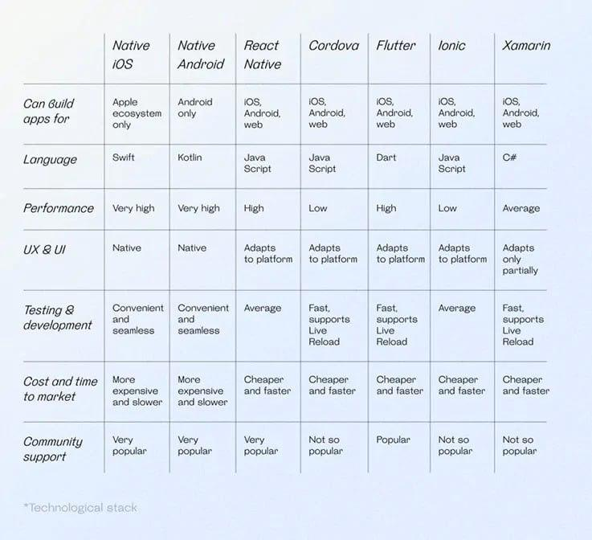
Framework for mobile apps
Types of apps
Programming languages & frameworks
Architectures
User requirements
Cost estimation
Key steps
Src: Scaler

Slide 16
04
Architectures and design patterns
MVC
MVVM
Clean architecture
SPA
Microservices

Slide 17
Architecture and Design patterns
Types of apps
Programming languages & frameworks
Architectures
User requirements
Cost estimation
Key steps
Mobile application architectures and design patterns play a crucial role in organizing and structuring the codebase, improving maintainability, and enhancing the overall performance of mobile apps. Some of them are:
1) Model-View-Controller (MVC)
2) Model-View-ViewModel (MVVM)
3) Clean architecture
4) Single-page Application (SPA)
5) Microservices Architecture

Slide 18
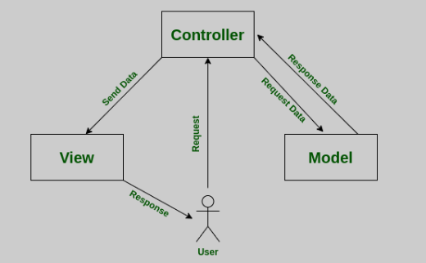
1/5
Model-View-Controller (MVC)
Types of apps
Programming languages & frameworks
Architectures
User requirements
Cost estimation
Key steps
Data and business logic(data structure, data validation, perform computation implementation
UI: present data to the user and capture user interaction

Slide 19
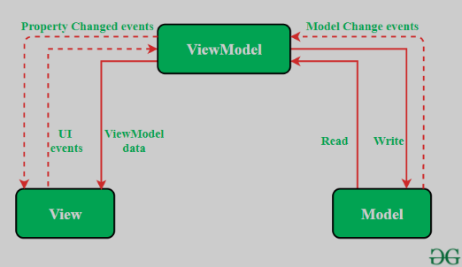
2/5
Model-View-ViewModel (MVVM)
Types of apps
Programming languages & frameworks
Architectures
User requirements
Cost estimation
Key steps
Model: data,
the View handles UI rendering, and the View Model acts as an intermediary between the Model and the View

Slide 20
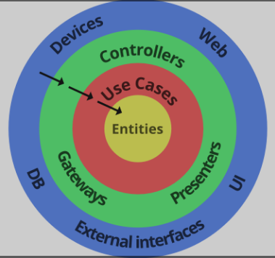
3/5
Clean architecture
Types of apps
Programming languages & frameworks
Architectures
User requirements
Cost estimation
Key steps
Domain layer
Interactor layer (use cases)
Interface adapters
Frameworks and drivers

Slide 21
4/5
Single-page Application (SPA)
Types of apps
Programming languages & frameworks
Architectures
User requirements
Cost estimation
Key steps
It is a web application architecture that allows for a fluid and interactive user experience by dynamically updating the web page without requiring a full page reload. the initial HTML, CSS, and JavaScript are loaded once, and subsequent interactions and content updates are handled through asynchronous data retrieval and manipulation.

Slide 22
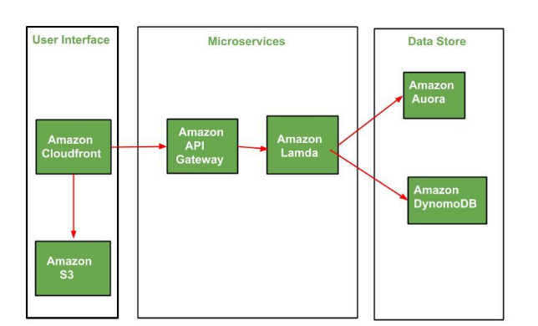
5/5
Microservices Architecture
Types of apps
Programming languages & frameworks
Architectures
User requirements
Cost estimation
Key steps
App is divided into small, independent services that can be developed, deployed, and scaled individually. Each service focuses on a specific business capability and communicates with other services through well-defined APIs

Slide 23
05
Collect and analyze user requirements

Slide 24

Collect and analyze user requirements
Types of apps
Programming languages & frameworks
Architectures
User requirements
Cost estimation
Key steps
You can use various methods, such as surveys, interviews, focus groups, personas, user stories, and user journeys, to collect and analyze data about the users
Identify the key stakeholders
Business owners
Understand the business needs
goals
Objectives
Identify the user requirements
Needs
Pain points
Define the functional requirements
Data input
Users
Decision makers
Pain points
goals
Usability
Accessibility
Outputs
Integration other syst
Reporting
analytics

Slide 25
Collect and analyze user requirements
Types of apps
Programming languages & frameworks
Architectures
User requirements
Cost estimation
Key steps
You can use various methods, such as surveys, interviews, focus groups, personas, user stories, and user journeys, to collect and analyze data about the users
Define the technical requirements
Prioritize the requirements
Platforms
Document the requirements
help ensure that the most critical requirements are addressed first and that the project stays on track
Technologies
Infrastructure that will be used
Use cases
User stories
Functional specifications
Technical specifications

Slide 26
Types of apps
Programming languages & frameworks
Architectures
User requirements
Cost estimation
Key steps
Throughout the requirements gathering and design process, it’s important to remember one thing:
Design like you know everything but listen like you know nothing

Slide 27
06
Cost estimation
Key determination of development cost
Cost estimation process

Slide 28
Cost estimation
Types of apps
Programming languages & frameworks
Architectures
User requirements
Cost estimation
Key steps
The price of building an app highly depends on its functionality and the wages of those who are going to build it. Every feature takes a number of hours to program, and the more complex the app, the higher will be the price of building and maintaining it after release.

Slide 29
Key Determinate of Development Cost
Types of apps
Programming languages & frameworks
Architectures
User requirements
Cost estimation
Key steps
1/2
App Complexity and Functionality
Targeted Platforms
UI/UX Design
Backend Development
Development Team Structure

Slide 30
Cost Estimation Process
Types of apps
Programming languages & frameworks
Architectures
User requirements
Cost estimation
Key steps
2/2
Define apps requirements
Break down the development process
Consider Development Team Structure
Additional Costs

Slide 31
Example
Types of apps
Programming languages & frameworks
Architectures
User requirements
Cost estimation
Key steps
Here's a simplified formula to provide a preliminary cost estimate:
Total Development Time (hours) x Hourly Rate = Estimated Cost
For instance, if developing a basic Android app requires 1000 hours at a rate of $40/hour,
the estimated cost would be $40,000.

Slide 32
07
Key steps for dev process

Slide 33
Keys steps for Development process
Types of apps
Programming languages & frameworks
Architectures
User requirements
Cost estimation
Key steps
01
strategy of development
02
analysis and planning
03
UI/UX design
04
support and performance Monitoring(KPIs)
app development (frontend, backend, middleware)
05
application testing
06
Deployment
07
Src: https://www.velvetech.com/blog/mobile-app-development-process/

Slide 34
08
CONCLUSION
Recap of the work

Slide 35
CONCLUSION
In conclusion, mobile app development encompasses different types of apps, including native, web, and hybrid, which utilize programming languages like Swift, Objective-C, Java, Kotlin, HTML, CSS, and JavaScript, along with frameworks such as React Native and Flutter. Architectural patterns like MVC, MVVM, and Clean Architecture help organize the app's structure. Analyzing user requirements is crucial for defining functionalities and designing a seamless user experience. The choice of programming language depends on factors such as the target platform, development resources, performance requirements, and the desired level of access to device capabilities.

Slide 36
—thought
It’s just important to remember that work doesn’t stop once your app has been deployed. In fact, it’s only starting.

Slide 37
References
1. Amazon from: https://aws.amazon.com/compare/the-difference-between-web-apps-native-apps-and-hybrid-apps/?nc1=h_ls https://aws.amazon.com/mobile/mobile-application-development/
2. Appivo from https://www.appivo.com/articles/7-key-steps-for-good-app-requirements/
3. BairesDevBlog
4. velvetech from https://www.velvetech.com/blog/mobile-app-development-process/
5. https://itcraftapps.com/blog/estimating-mobile-app-development-costs-a-comprehensive-guide/
6. mobidev: https://mobidev.biz/blog/cross-platform-mobile-development-frameworks-comparison
7. Scaler
8. GreekForGreeks : https://www.geeksforgeeks.org/microservices-architecture-on-aws/

Slide 38
Thank You !

